Slide 1
Assigning IP addresses

Slide 2
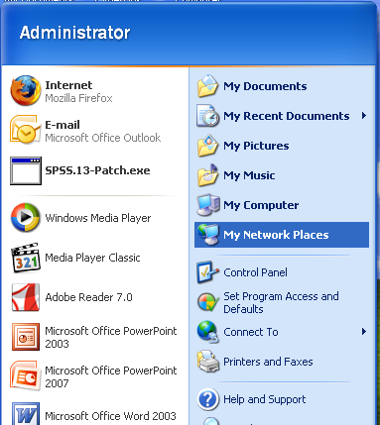
Assigning IP addresses
Start → Network Places → View Network Connections → Local Area Connection

Slide 3
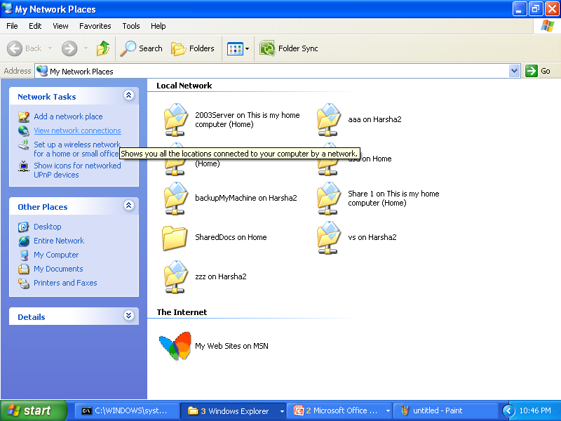
Network Places

Slide 4
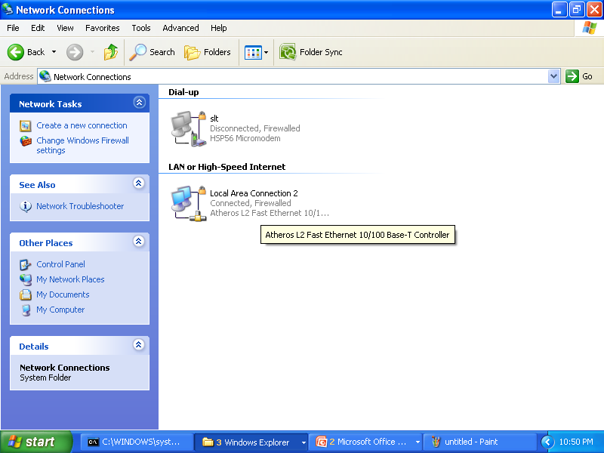
Network Connections

Slide 5
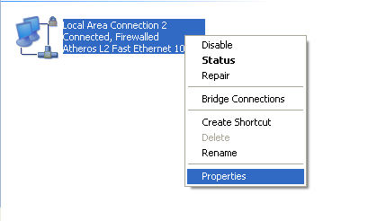
Local Area Connection

Slide 6
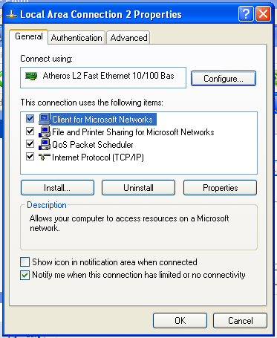
Local Area Connections Properties

Slide 7
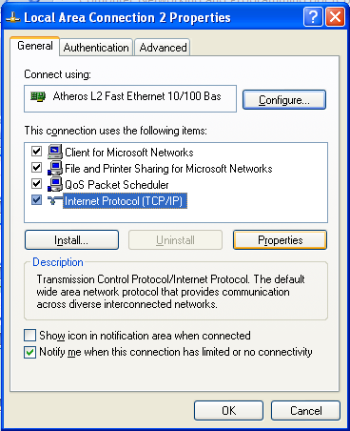
Internet Protocol (TCP/IP)

Slide 8
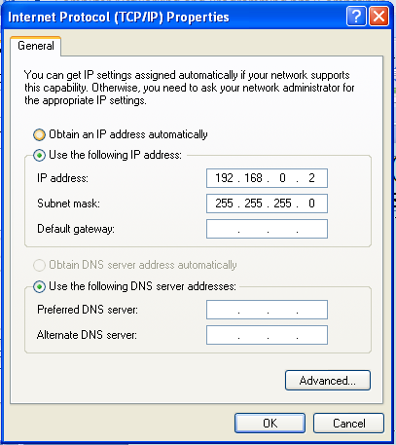
Internet Protocol (TCP/IP) Properties

